Slide 1
Lab (1) Channel Characterization

Slide 2
1) S-Parameters of the Channel

Slide 3
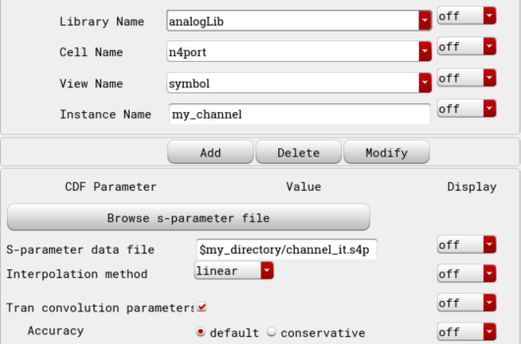
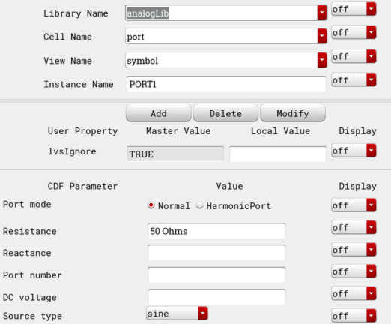
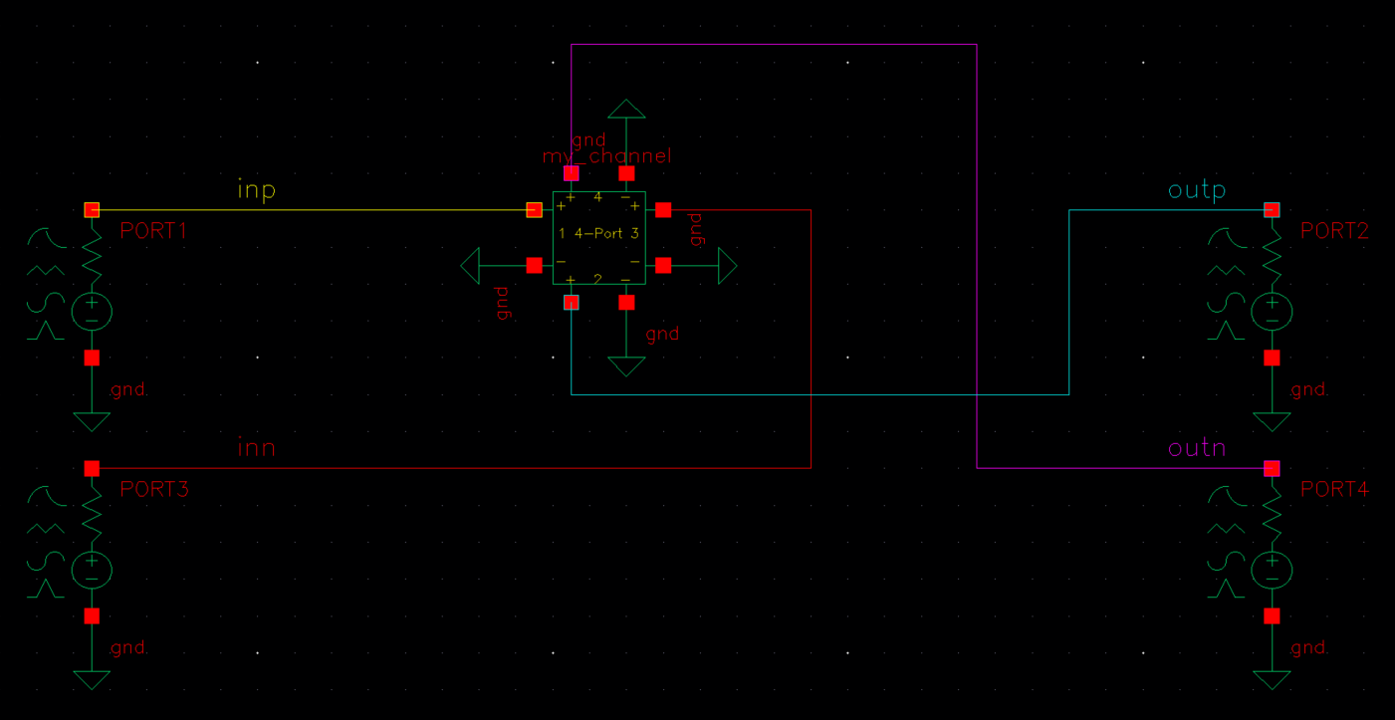
TB Schematics

Slide 4
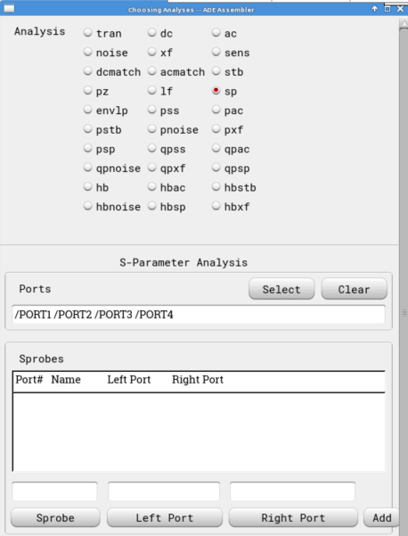
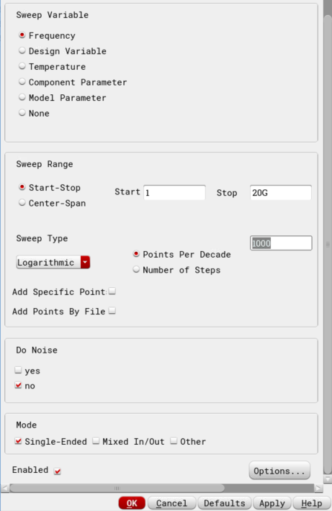
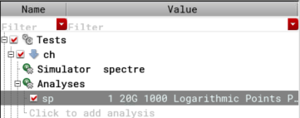
Analysis Setup

Slide 5
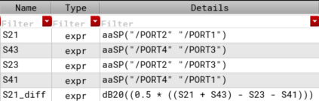
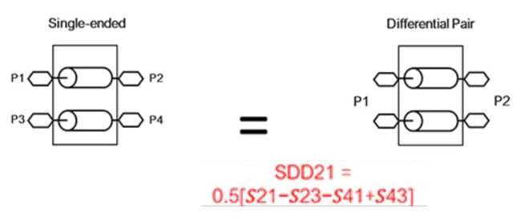
Test Expressions

Slide 6
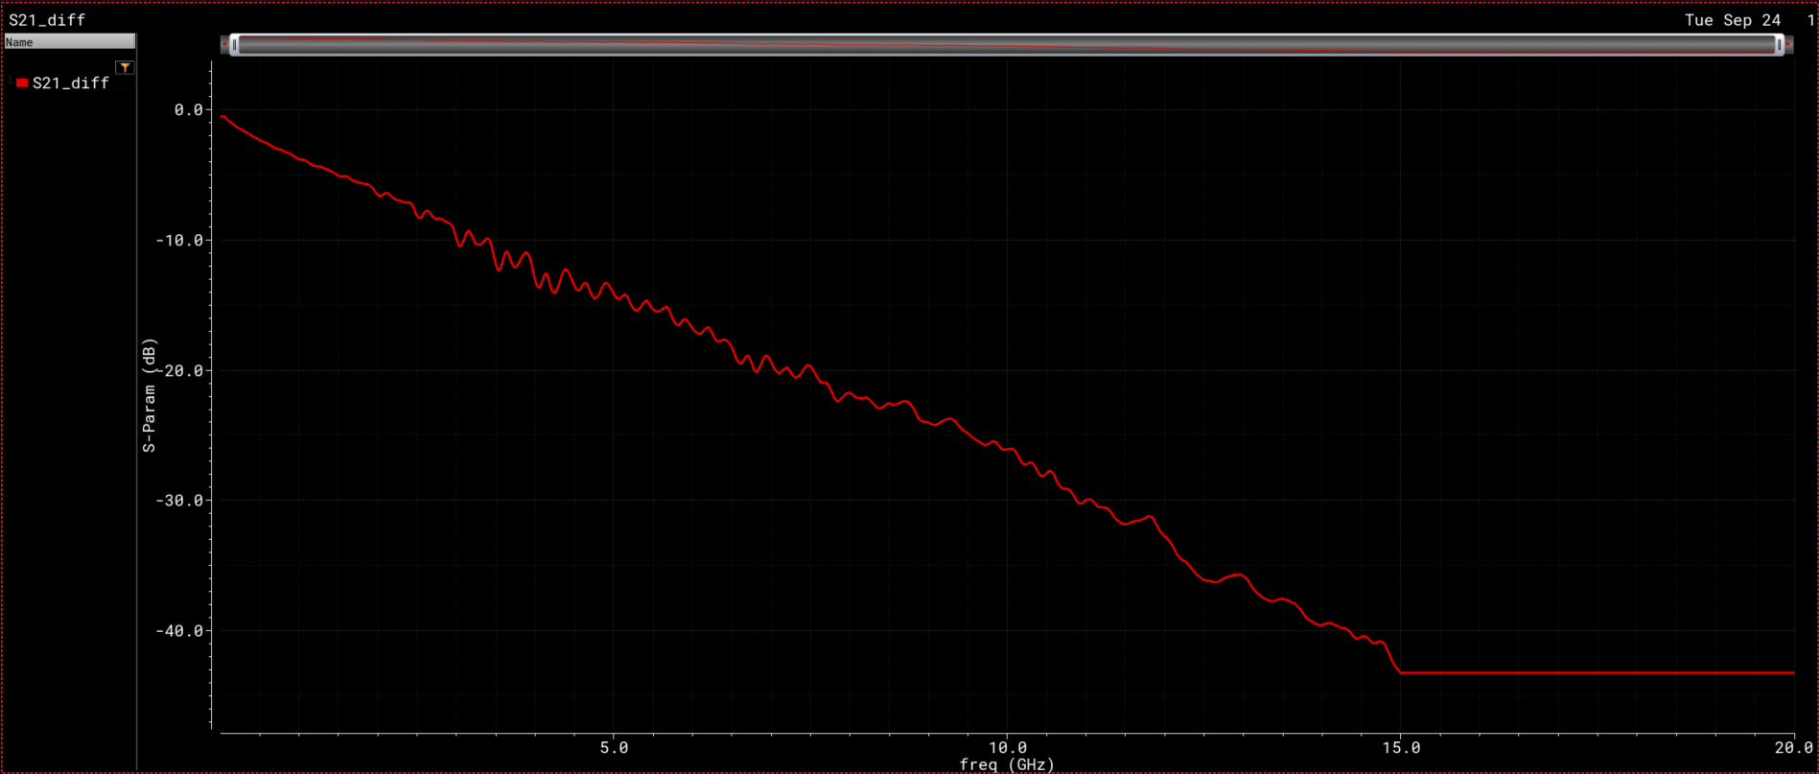
Results
Freq – linear Scale

Slide 7
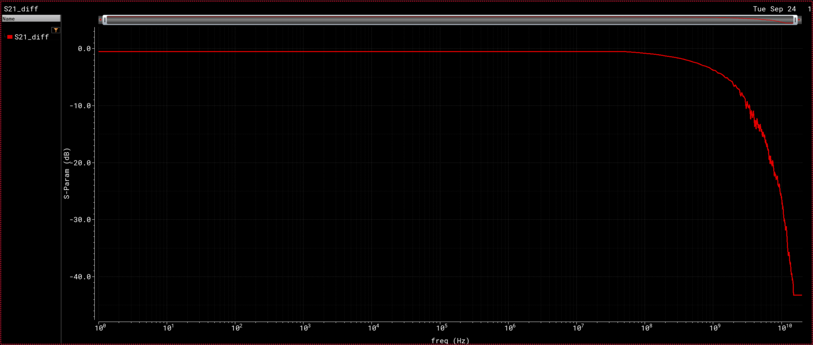
Results
Freq – log Scale

Slide 8
2) Pulse Response of the Channel ( 8 Gbps )

Slide 9
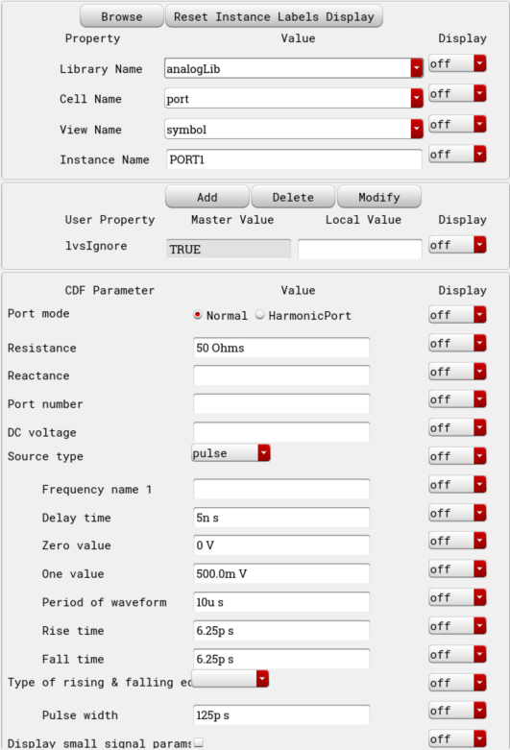

TB Schematics
0.5v pulse
With 50 Ohm
50 Ohm
-0.5v pulse
With 50 Ohm
50 Ohm

Slide 10
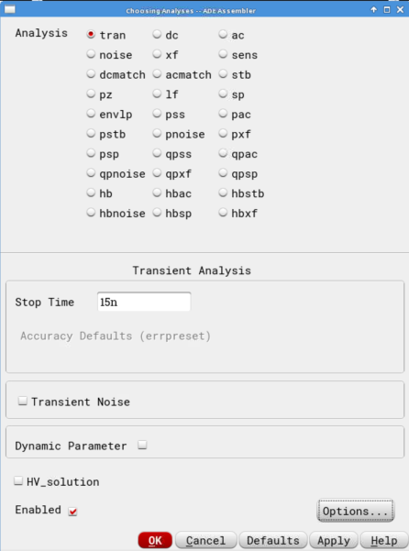
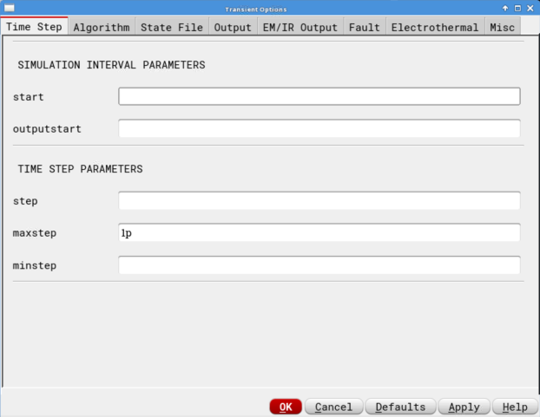
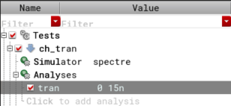
Analysis Setup

Slide 11
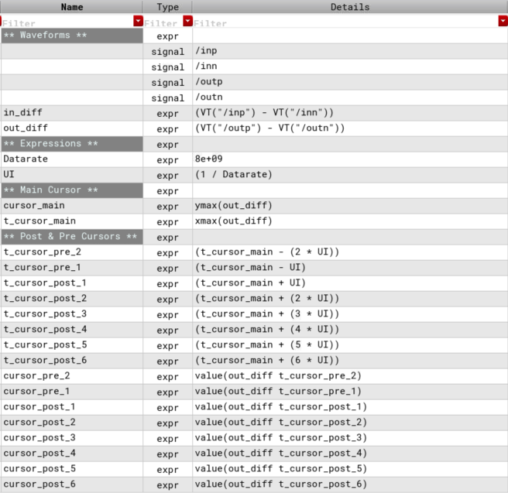
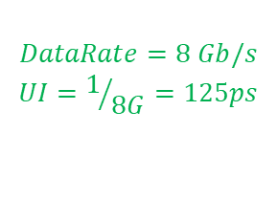
Test Expressions
$$DataRate=8 Gb/s$$
$$UI=1/{8G}=125ps$$

Slide 12
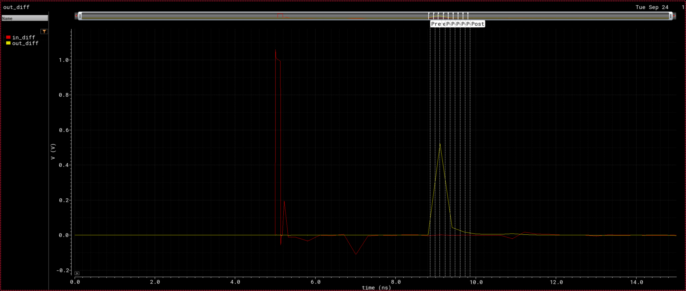
Results
Waveforms

Slide 13
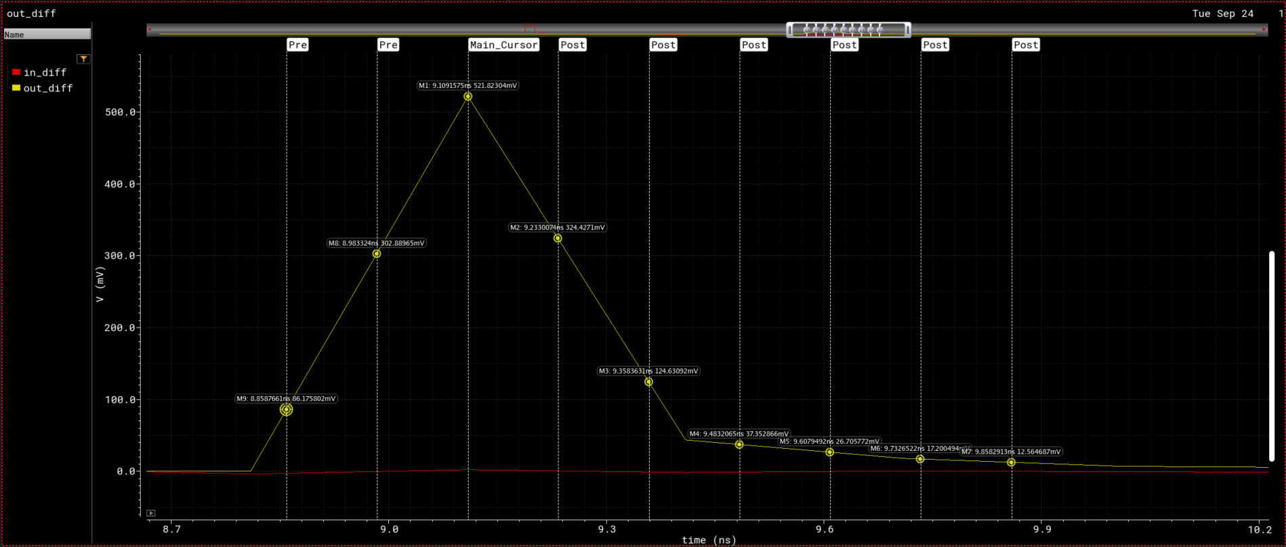
Results
Waveforms

Slide 14
Results
Cursor Values
Cursor Type | UI | Time (ns) | Output Value (mV)
Pre-Cursor | -2 | 8.859 | 86.86
Pre-Cursor | -1 | 8.984 | 304.3
Main-Cursor | 0 | 9.109 | 521.8
Post-Cursor | 1 | 9.234 | 322.6
Post-Cursor | 2 | 9.359 | 123.4
Post-Cursor | 3 | 9.484 | 37.27
Post-Cursor | 4 | 9.609 | 26.6
Post-Cursor | 5 | 9.734 | 17.14
Post-Cursor | 6 | 9.859 | 12.53

